Slide 1
CSS
Bootcamp
Part II
Review of CSS
Presented by Steven King

Slide 2
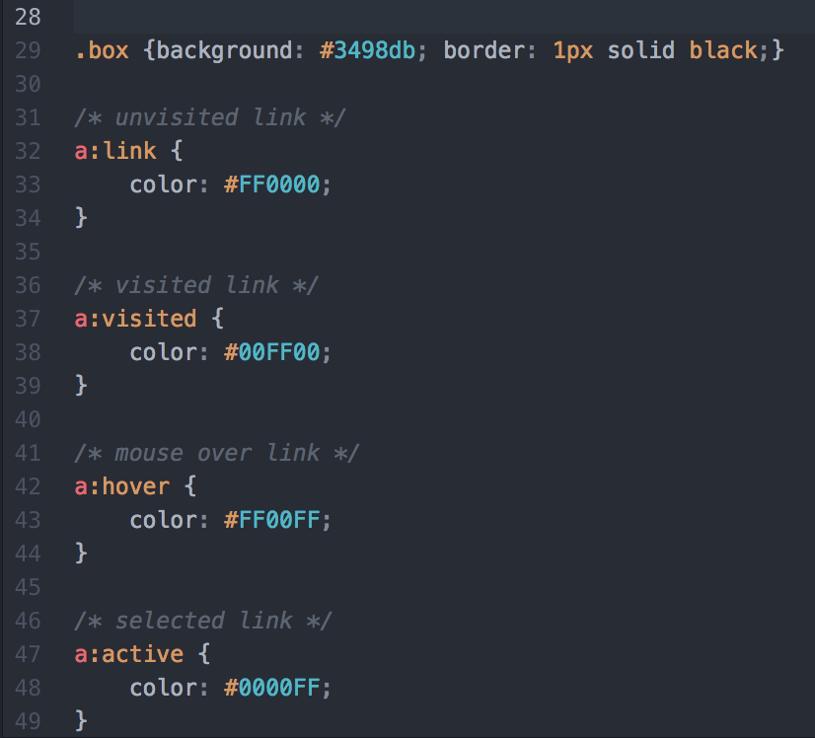
Make it
Readable
The readability of your CSS is incredibly important for you to work faster now and fixing things in the future
For me to grade it or your boss to do a code review
For other developers
Make multiple line styles

Slide 3
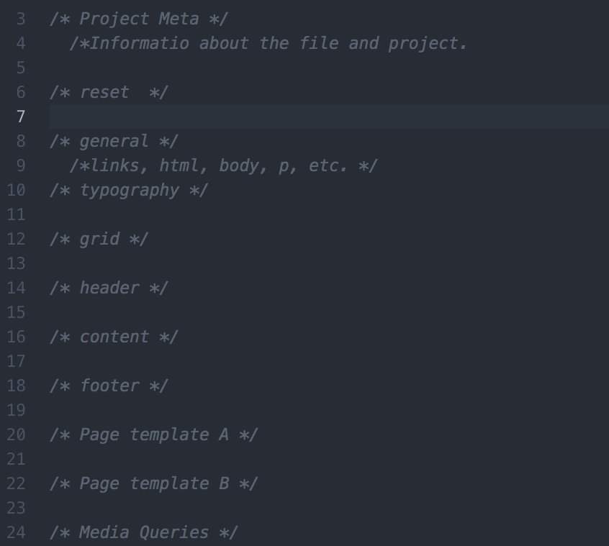
Be Organized
It always makes sense to lay your stylesheet out in a way that allows you to quickly find parts of your code.
I recommend a top-down format that tackles styles as they appear in the source code.
Consider a Table of Contents

Slide 4

Be
Consistent
Keep to a plan!

Slide 5
Be Consistent
.my-style{}
.myStyle{}
.my-Style{}
I can’t remember??
I prefer:
.my-style{
property:value;
};
You should start to develop your own “sub-language” of CSS that allows you to quickly name things.
Consistent style naming convention

Slide 6

Build HTML
First
You save time if you create the entire HTML mockup first.
Because you know all the elements of your site layout, but you don’t know what CSS you’ll need with your design

Slide 7
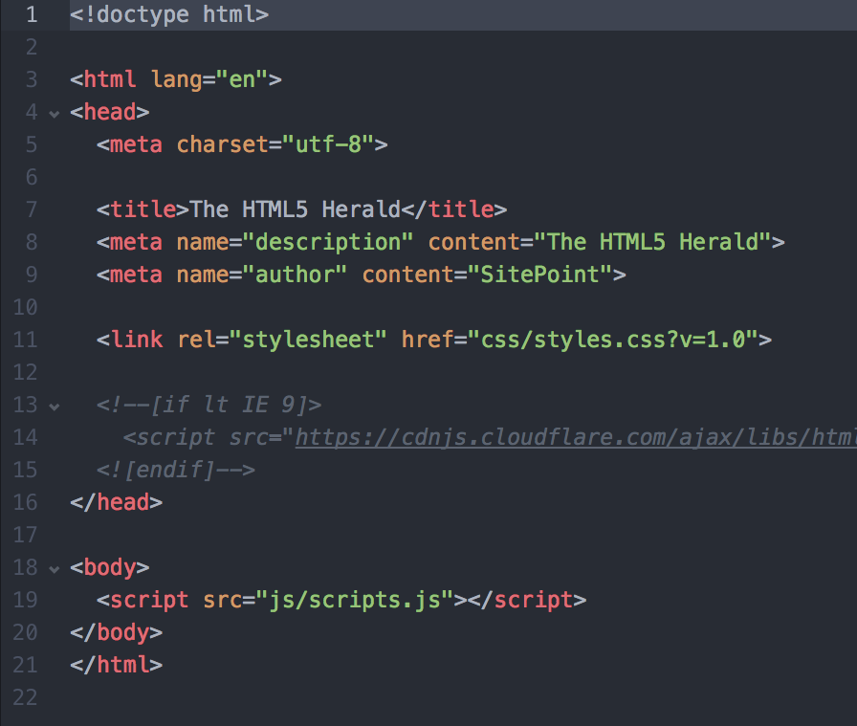
Correct Doctype
The doctype declaration matters a whole lot on whether or not your markup and CSS will validate.
In fact, the entire look and feel of your site can change greatly depending on the DOCTYPE that you declare

Slide 8
Block vs.
Inline
Elements
Inline Elements:
b, big, i, small, tt
abbr, acronym, cite, code, dfn, em, kbd, strong, samp, time, var
a, bdo, br, img, map, object, q, script, span, sub, sup
button, input, label, select, textarea, span
Block Elements
div, h1...h6, p, ul, li, table, blockquote, pre, form
Block elements are elements that naturally clear each line after they’re declared, spanning the whole width of the available space.
Inline elements take only as much space as they need, and don’t force a new line after they’re used.

Slide 9

Comment
Everything
And comment more

Slide 10
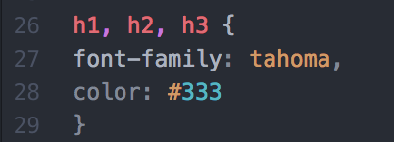
Combine
Elements
Elements in a stylesheet sometimes share properties. Instead of re-writing previous code, why not just combine them?
For example, your h1, h2, and h3 elements might all share the same font and color:

Slide 11
Compound
Classes
it’s beneficial to add multiple classes to an element. Let’s say that you have a <div> “box” that you want to float right, and you’ve already got a class .right in your CSS that floats everything to the right. You can simply add an extra class in the declaration.

Slide 12
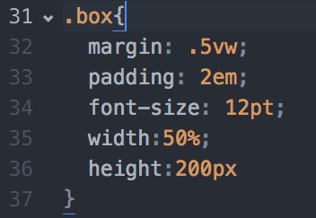
Know the right unit
px and pt are static
%, em, vw, vh are dynamic
Each has a purpose.

Slide 13
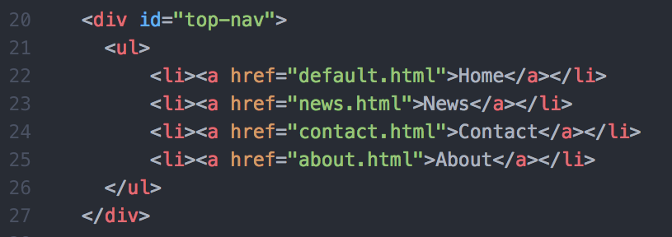
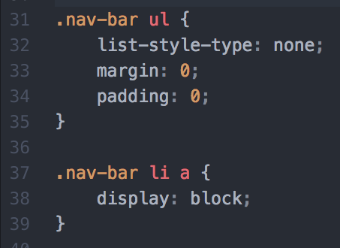
Power in the List
Lists are a great way to present data in a structured format that’s easy to modify the style. Thanks to the display property, you don’t have to just use the list as a text attribute.
Lists are also great for creating navigation menus and things of the sort.

Slide 14
Validation
Always validate your HTML and CSS
.

Slide 15
Assignment
Putting into practice

